Slide 1
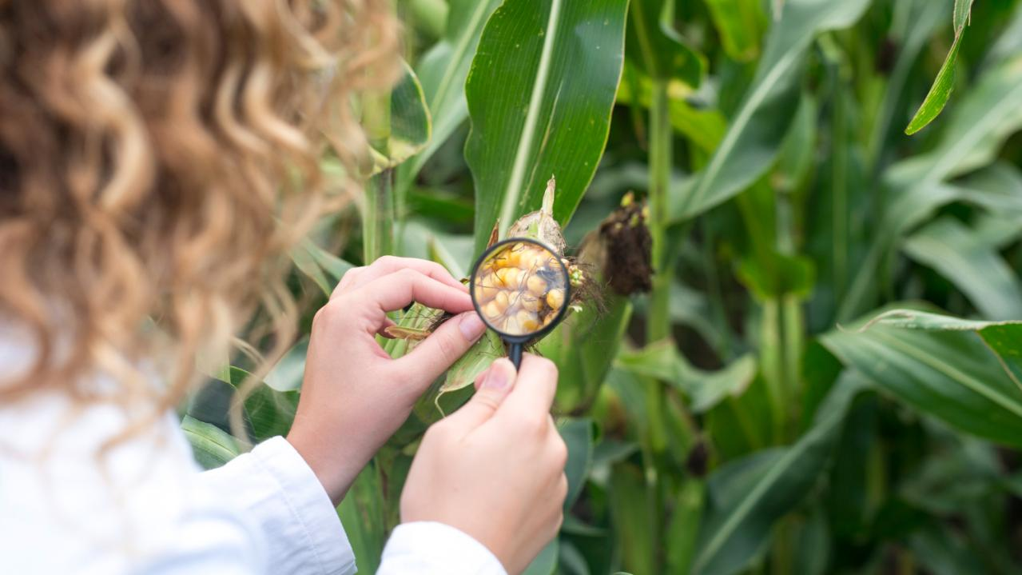

Climate Change Impact on Agriculture
BY
AUWAL ABDULKARIM MALIYA

Slide 2
OUTLINE
Introduction
Problem Statements
Why this Analysis Matters
Methodology
Data Summary
Key Findings
Limitation
Improvement
Recommendations
Conclusion
Agricultural

Slide 3
INTRODUCTION
This analysis on ‘Climate Change impact on Agriculture’ explores how evolving climate conditions are influencing crop yields and agricultural sustainability.
We will take a data-driven journey through historical trends, regional variations, and key correlations to reveal actionable insights that can help shape future strategies in agriculture.
Agricultural

Slide 4
PROBLEM STATEMENTS
To reveal the factors influencing agricultural productivity.
To identify which variables most strongly drive high yields and economic returns.
Agricultural

Slide 5
WHY THIS ANALYSIS MATTERS
To understand what drives successful crop production.
To pinpoint effective strategies and identify vulnerabilities.
To help stakeholders make informed decisions that support resilient and sustainable agriculture.
To promoting sustainable resource management amid climate change
Agricultural

Slide 6
OBJECTIVES:
To examine crop yields in relation to climate change
To uncover the key factors behind agricultural productivity
To figure out operational practices related to economic factors.
Agricultural

Slide 7
METHODOLOGY
DATA
UNDERSTANDING
UNCOVER
INSIGHTS
DATA
CLEANING
METHODOLOGY
DATA
ANALYSIS
DATA
MODELING
Agricultural

Slide 8
DATA SUMMARY
Total Number Countries
10
Crop Types
Adaptation Strategies
10
5
Nigeria
China
USA
India
Australia
Argentina
Canada
France
Russia
Brazil
Barley
Coffee
Corn
Cotton
Fruit
Rice
Soyabeans
Sugarcane
Vegetable
Wheat
Water Management
Drought Resistance
Crop Rotation
Organic Farming
No Adaptation

Slide 9
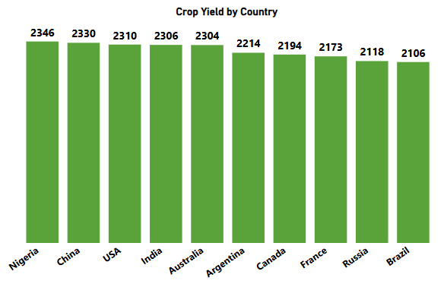
KEY FINDINGS
This Bar chart shows the ranking of countries by crop yield.
From the result, Nigeria leads, followed by China, USA, India, and others.
The key insight here is to Identifies top-performing countries in terms of agricultural productivity.
This means Nigeria, despite challenges, is delivering remarkable output per area of land.

Slide 10
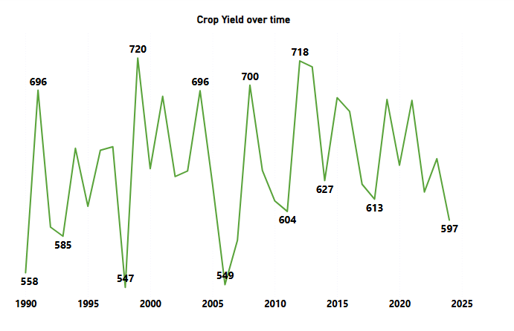
KEY FINDINGS
Crop yield in MT over time

Slide 11
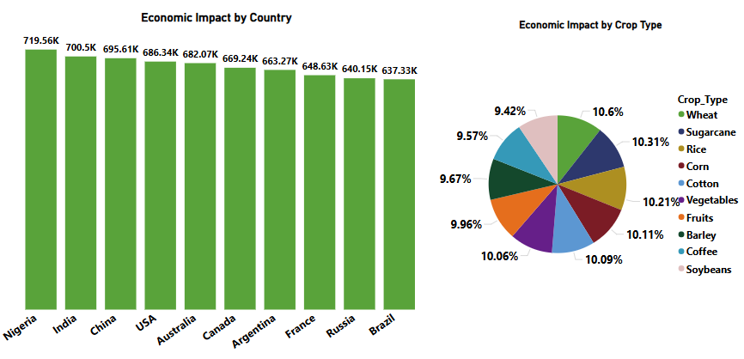
KEY FINDINGS

Slide 12
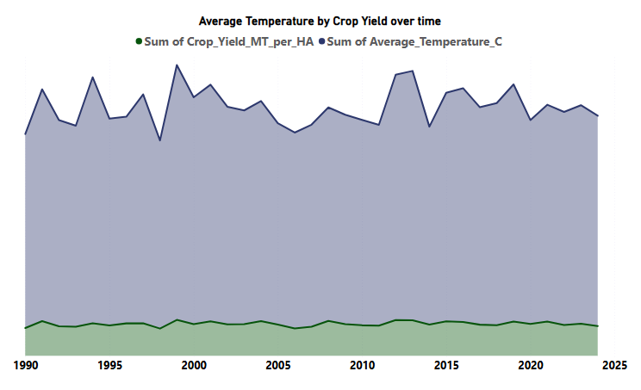
KEY FINDINGS

Slide 13
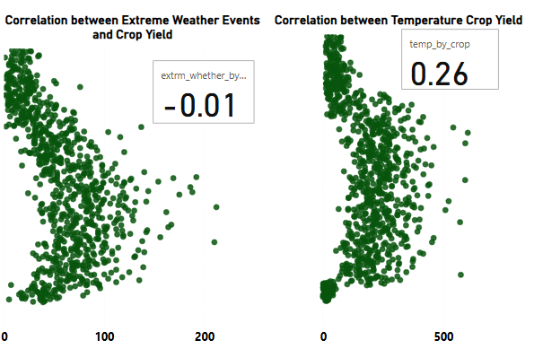
KEY FINDINGS

Slide 14
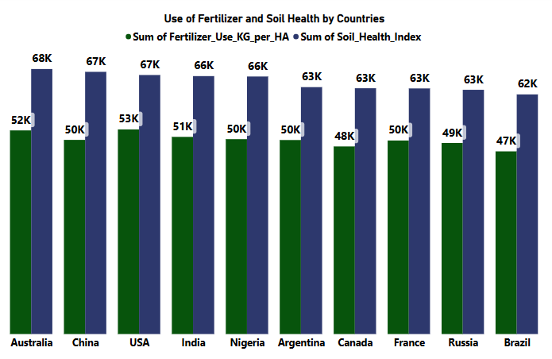
KEY FINDINGS

Slide 15
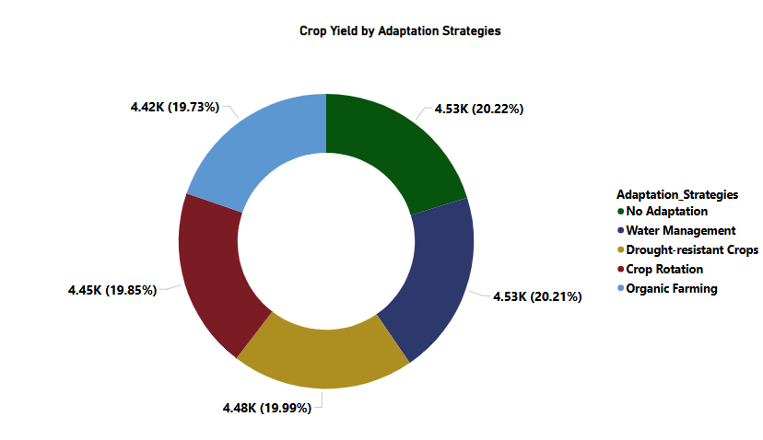
KEY FINDINGS

Slide 16
Limitation
Limited Data Scope: The dataset is not large, potentially there are missing crucial regional or temporal nuances.
Aggregation Bias: Data aggregated at the country level hide important local variations and differences.
Potential Data Collection Bias: Variations in data collection methods across regions introduce bias into the results.
Generalizability Concerns: Due to the limited and aggregated nature of the data, the model’s conclusions may not apply broadly to all contexts.
Methodological Flaws: The analysis overlook other influential factors, reducing the overall comprehensiveness of the insights.

Slide 17
IMPROVEMENT
Expand Data Collection: We would gather a larger dataset, including regional and seasonal data, to capture a full picture of agricultural performance across different geographies.
Enhance Data Quality and Consistency: With better resources and team support, we would implement standardized data collection procedures and conduct rigorous quality checks to minimize bias and ensure data reliability.
Integrate Additional Variables: Adding other relevant factors such as soil types, local climate trends, and socioeconomic indicators would create a more robust model that better explains variations in crop yield.
Utilize Advanced Analytical Methods: With more time and expertise, advanced statistical and machine learning techniques could be employed to uncover non-linear relationships and interactions among variables for deeper insights.

Slide 18
Recommendations
Invest in High-Yield Markets
Enhance Water Management Infrastructure
Optimize Crop Mix and Economic Portfolios
Embrace Technological Innovations
Adopt a Diversified Adaptation Strategy

Slide 19
Conclusion
This analysis clearly demonstrates that climate change—through rising temperatures and irregular precipitation—significantly impacts agricultural productivity, leading to lower crop yields in many regions. While some areas exhibit resilience thanks to effective farming practices and adaptive measures, others remain highly vulnerable, underscoring the urgent need for tailored, data-driven interventions to safeguard food security and ensure sustainable agricultural practices in the face of ongoing climate challenges.

Slide 20

Thank You!
(:

